Slide 1

(IInd) Project Presentation on AyurSense: An Intelligent Ayurvedic Recommendation System
Presented by :
Manya Thapliyal (2200950100048)
Prashant Bisht (2200950100059)
Under the Guidance of : Mrs. Roovi Goswami
DEPARTMENT OF COMPUTER SCIENCE & ENGINEERING
MGM’s College of Engineering & Technology, Noida

Slide 2

AyurSense
Ayur = Taken from Ayurveda, meaning knowledge of life. Sense = Stands for intelligent, understanding, awareness or perception. In today’s fast-paced world, lifestyle-related disorders such as obesity, diabetes, hypertension, and stress have become increasingly common due to unhealthy eating habits, lack of physical activity, and rising stress levels. While people often turn to quick fixes or random online remedies, these solutions are usually not personalized and may not provide effective results. Ayurveda, the ancient Indian system of medicine, offers natural, holistic, and preventive approaches to health. However, the lack of accessibility and personalization has limited its widespread adoption in modern lifestyles. To bridge this gap, AyurSense is designed as a personalized Ayurvedic health recommendation system that combines traditional Ayurvedic wisdom with modern technology, making health guidance simple, accessible, and user-friendly for everyone.

Slide 3




PROBLEM STATEMENT
01 Many people remain unaware of the rich knowledge Ayurveda offers for maintaining health and preventing diseases. Due to limited awareness, individuals often overlook natural remedies that could effectively support their well-being.
02 Most available Ayurvedic suggestions are generic in nature, failing to consider individual body types, lifestyle, and health conditions. This lack of personalization often reduces the effectiveness of such remedies.
Lack of awareness about Ayurveda and its benefits
Generic remedies fail to provide personalized solutions
04 Because of this lack of awareness and the absence of proper solutions, people often rely on regular medicines or keep changing treatments frequently.
03 Such as business consulting for startups, financial planning for individuals, academic help for students, and skill development for professionals.
Frequent Shift in Treatment
No accessible platform for personalized Ayurvedic guidance

Slide 4
OBJECTIVES
To provide personalized Ayurvedic recommendations based on a user’s health quiz. The system analyzes individual responses to suggest remedies, yoga asana, and diet tips tailored to each person.
To promote natural remedies, yoga, and diet for maintaining good health. Users can adopt healthy lifestyle practices without relying on chemical-based medicines or generic advice.
To bridge the gap between modern lifestyle and Ayurvedic knowledge. AyurSense makes traditional Ayurvedic guidance accessible and practical for people with busy lives.
To create a user-friendly web application. The platform is designed to be simple, intuitive, and easy to navigate for all types of users.:
To raise awareness about Ayurveda and its benefits. The platform educates users about Ayurvedic principles, encouraging them to explore natural and holistic approaches to health.
To build trust through accurate and reliable recommendations. By using intelligent analysis and authentic Ayurvedic knowledge, AyurSense ensures users receive effective and dependable guidance.

Slide 5
Aspect | Existing System | Proposed System (AyurSense)
User Approach | People rely on Google, YouTube, or random online sources. Most advice is generic and not tailored to an individual’s specific health needs. | AI-powered quiz analyzes user responses. Recommendations are personalized for each user.
Remedies | Difficult to find trusted and authentic Ayurvedic remedies. Users may follow incorrect or ineffective tips. | Provides reliable and authentic Ayurvedic remedies. Suggestions include yoga and diet tailored to the user’s health profile.
Accessibility | Information scattered across multiple sources. Users spend time searching and verifying. | All information centralized in one user-friendly website. Users can easily access personalized guidance anytime.
Awareness | Low awareness of Ayurveda and its benefits. | Educates users about Ayurveda and its personalized benefits

Slide 6


Requirement Analysis Studied user needs and identified problems in existing systems.
Testing Module-wise testing for functionality. Ensured accuracy of recommendations.
System Design Designed workflow, architecture, and database schema. Divided the system into modules
METHODOLOGY
Deployment Hosted as a web application for accessibility.
Feedback & Improvement User feedback used for refining remedies and quiz questions.
Development Phase Frontend: HTML, CSS, Bootstrap. Backend: Flask (Python) / Node.js AI integration for personalized recommendations.

Slide 7
SYSTEM ARCHITECTURE
Feedback Module: Allows users to submit feedback on the recommendations for future improvement.
User: The person who interacts with the system by logging in and taking the health quiz.
1
6
Quiz Module: Collects information about the user’s health, lifestyle, and preferences through a simple questionnaire.
2
5
Output / Dashboard: Displays the recommendations in a user-friendly format, allowing users to view and follow them.
Backend (Flask/Node.js): Processes quiz responses, applies logic/AI to generate personalized recommendations.
3
4
Recommendation Engine: Analyzes user data and provides Ayurvedic remedies, yoga asana, and diet tips based on individual needs.

Slide 8
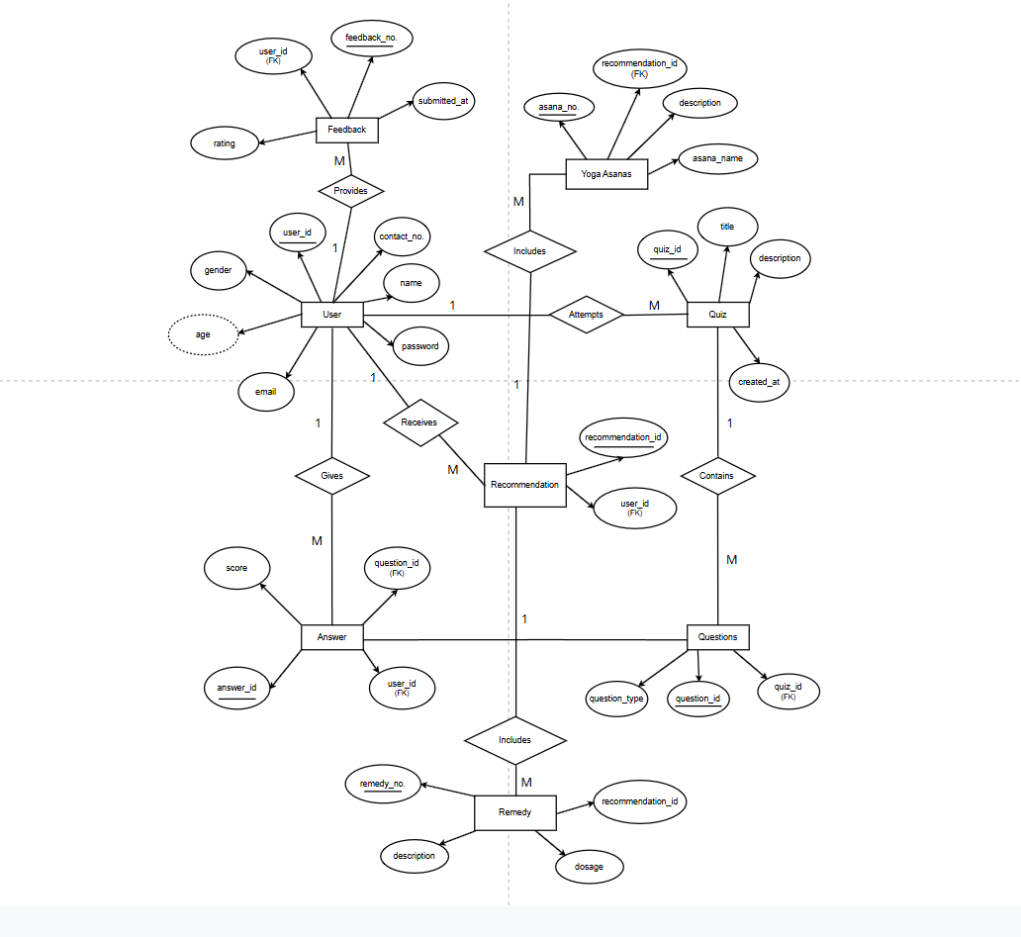
Entity-Relationship Diagram

Slide 9
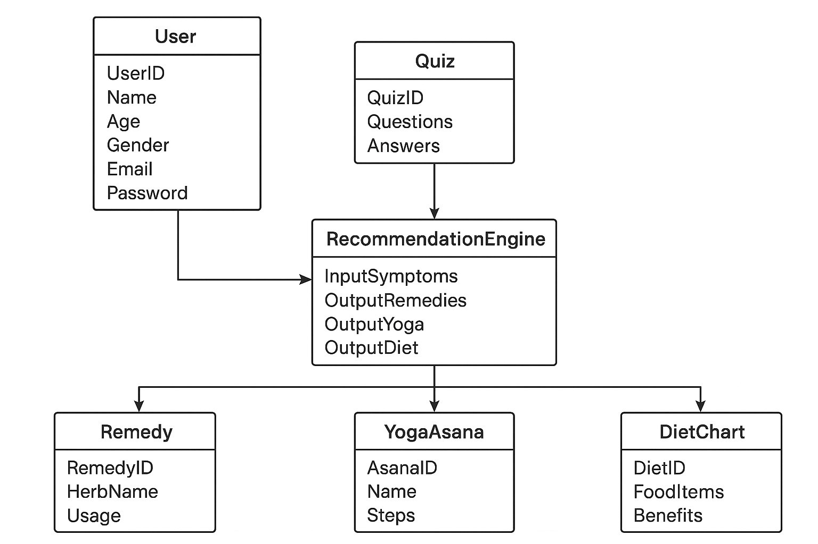
Class Diagram

Slide 10
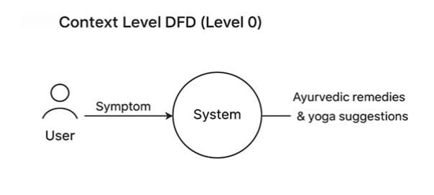
Data Flow Diagram

Slide 11
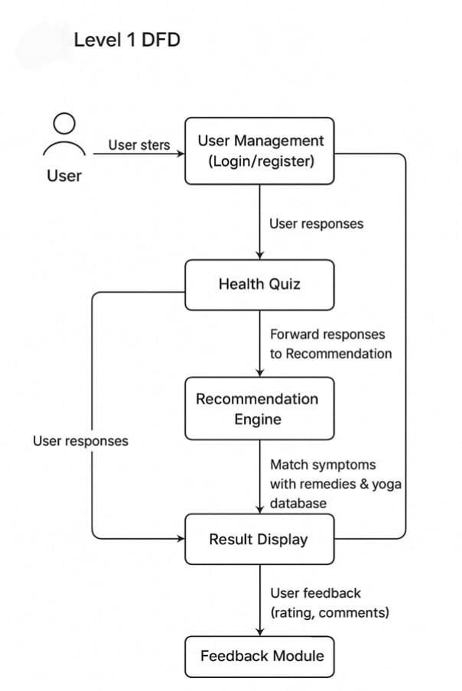

Slide 12
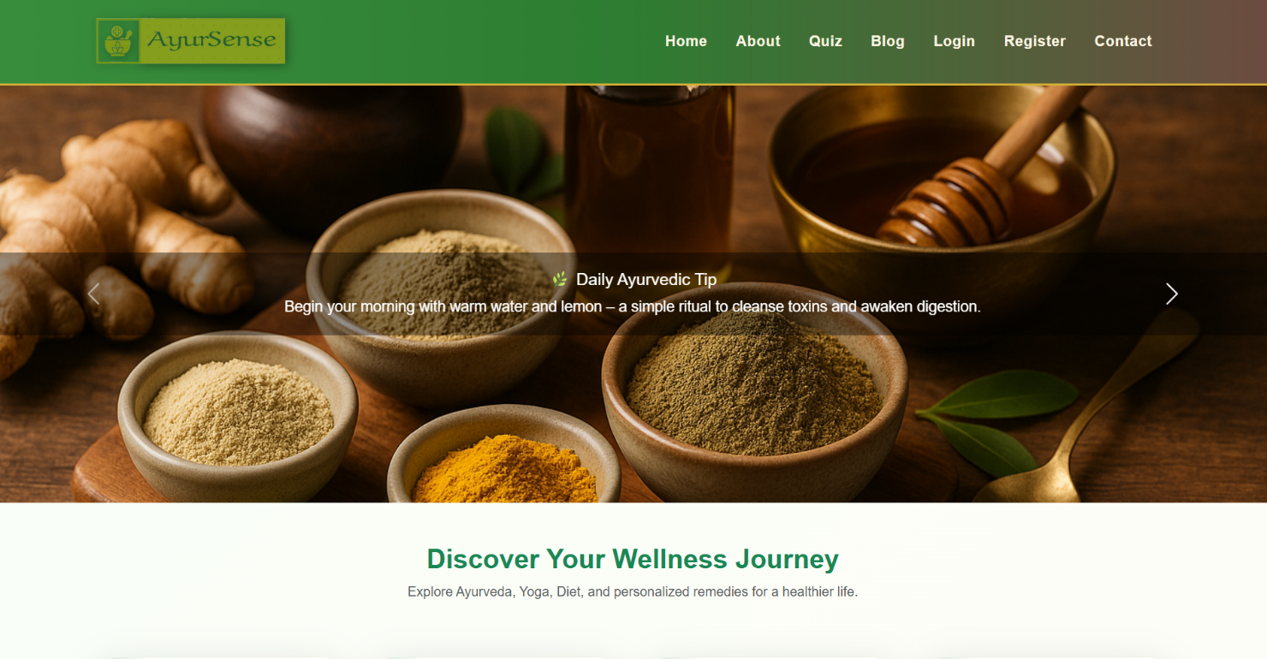
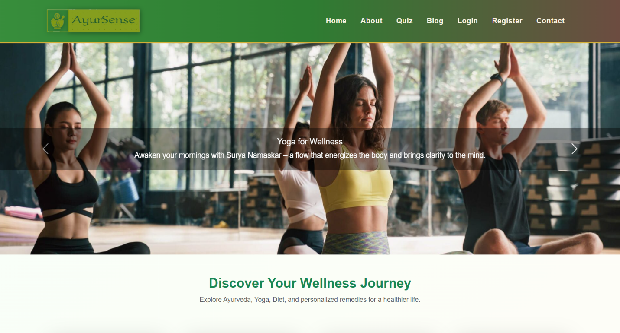
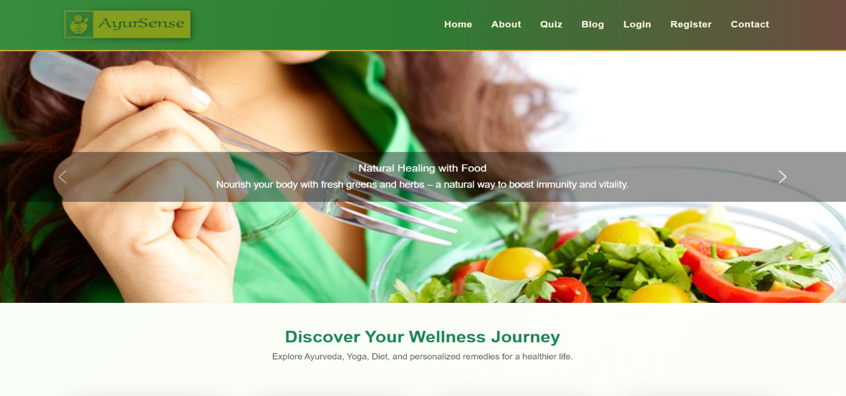
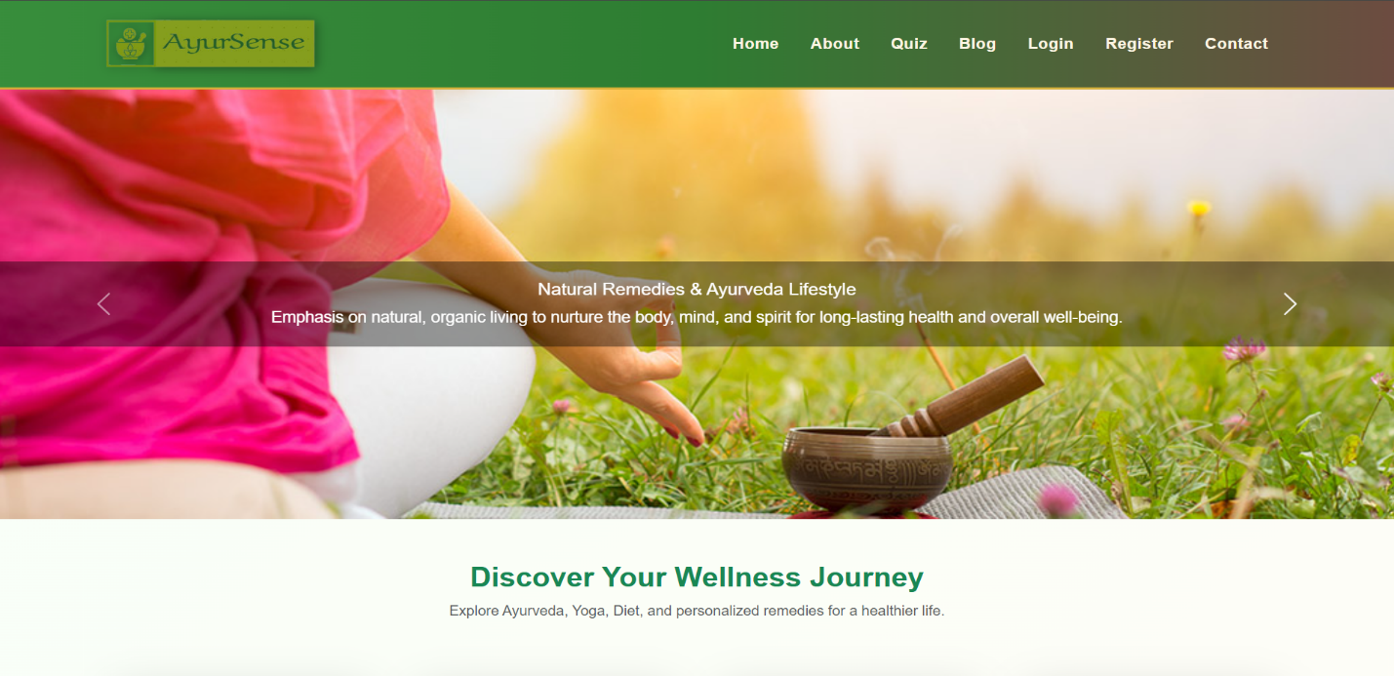

Slide 13
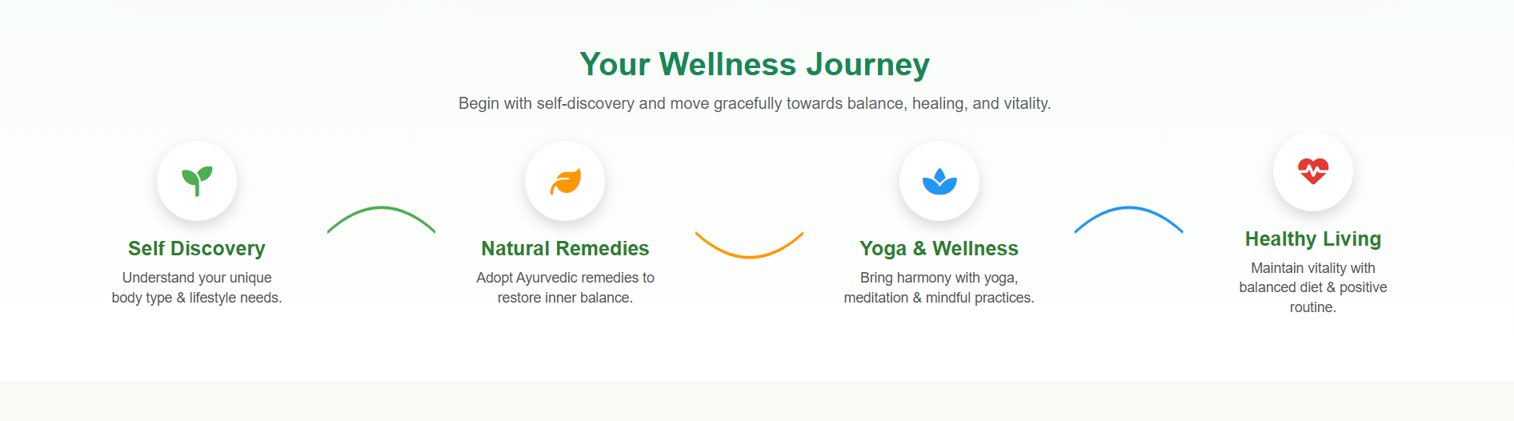
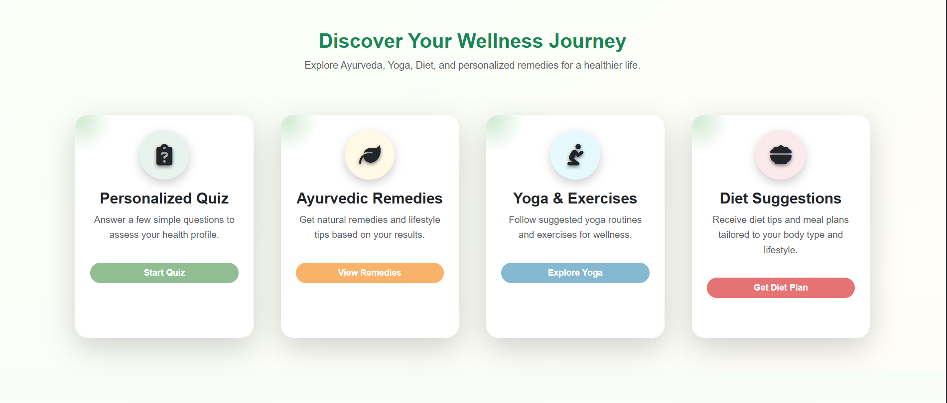
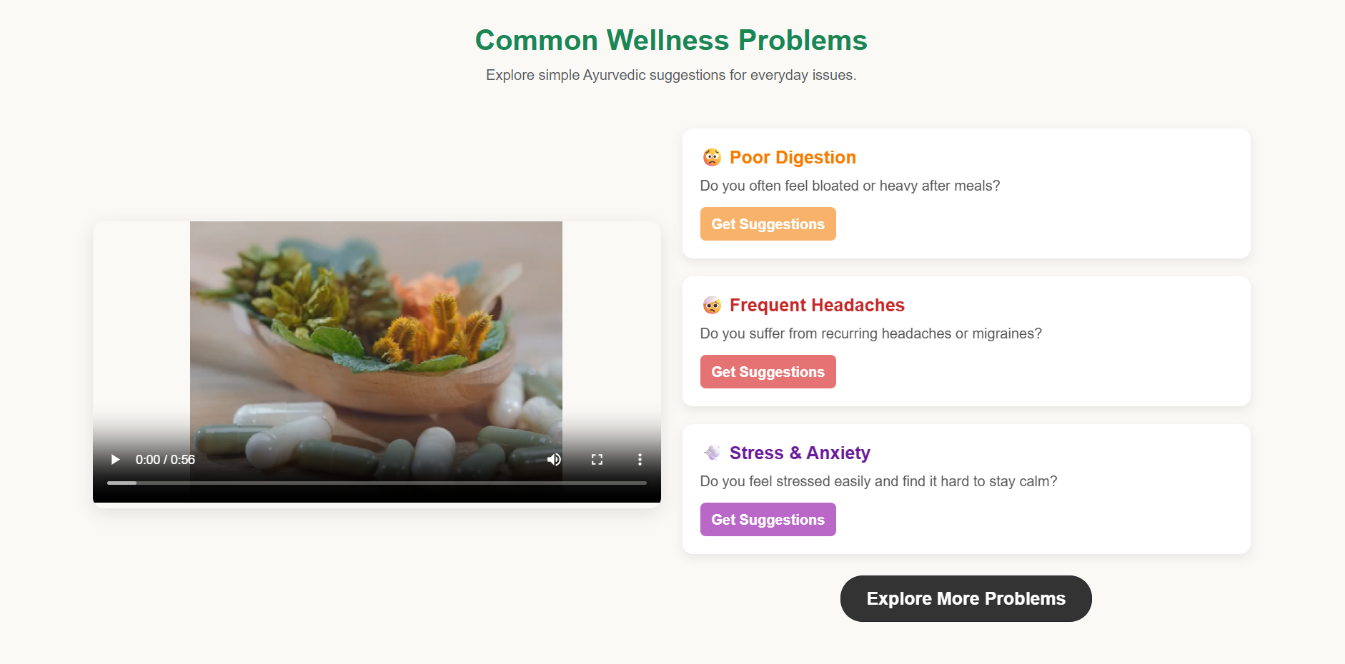

Slide 14
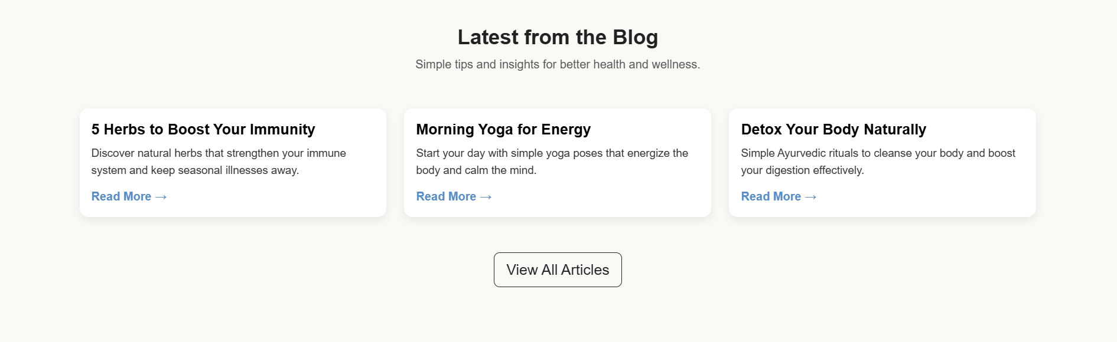
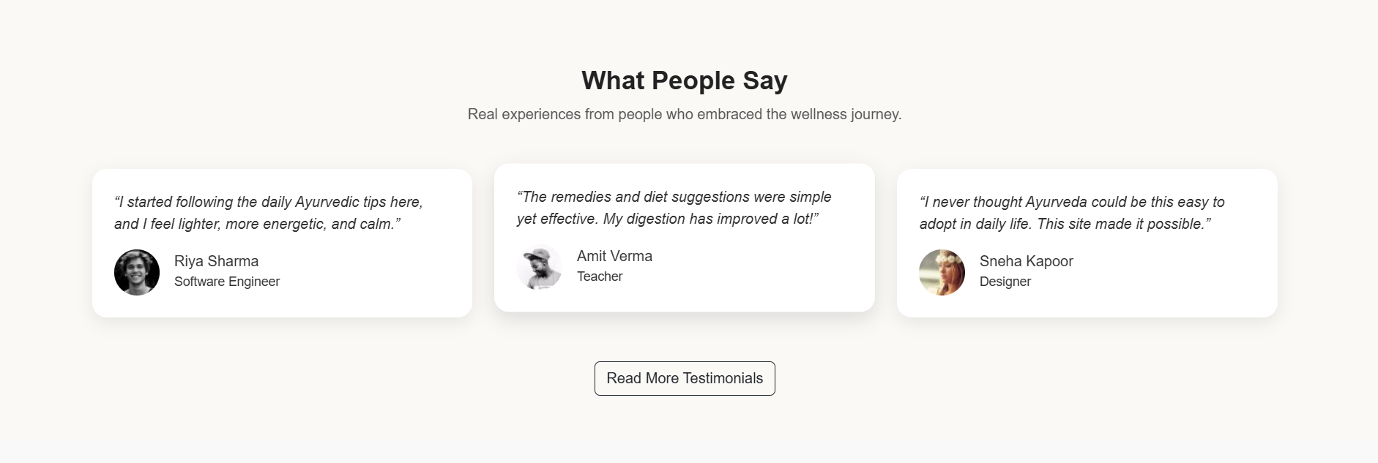

Slide 15
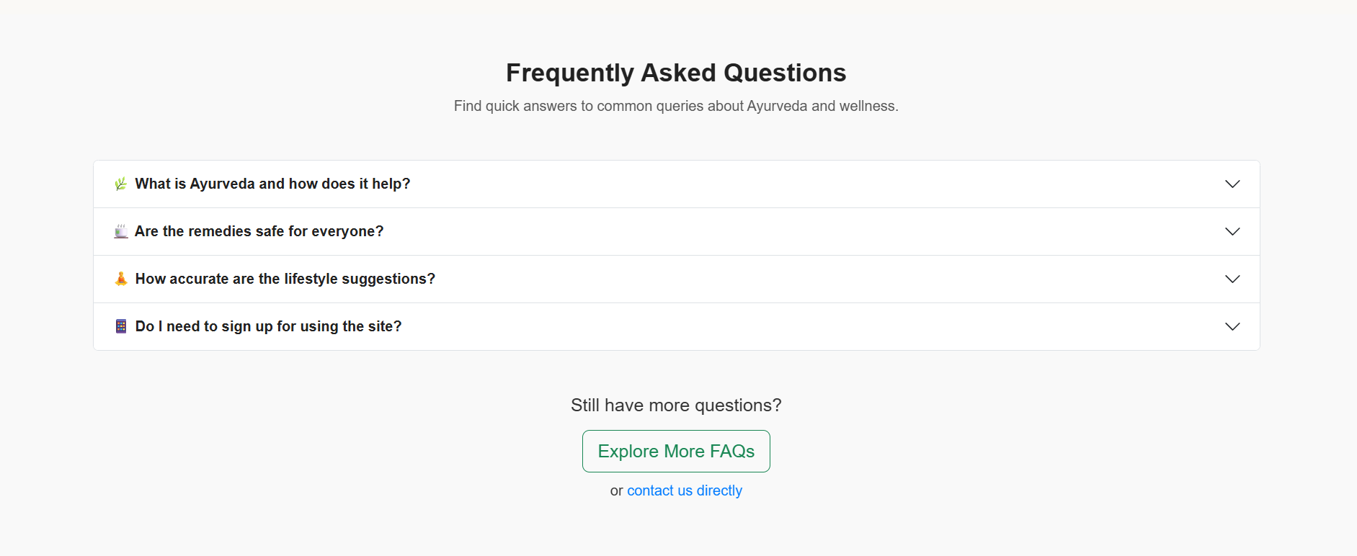

Slide 16
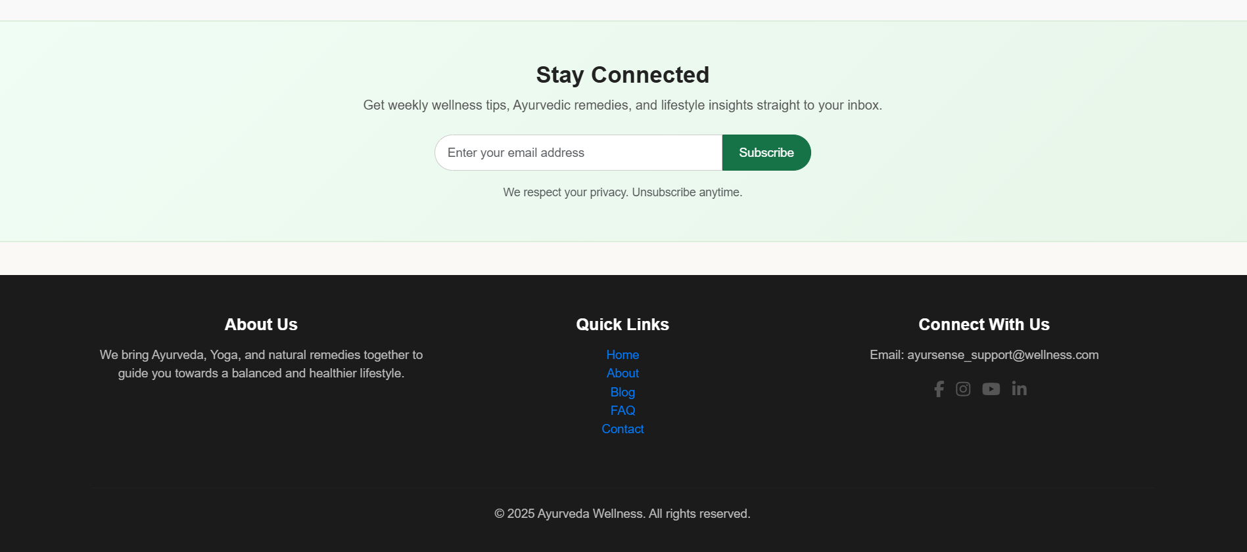

Slide 17
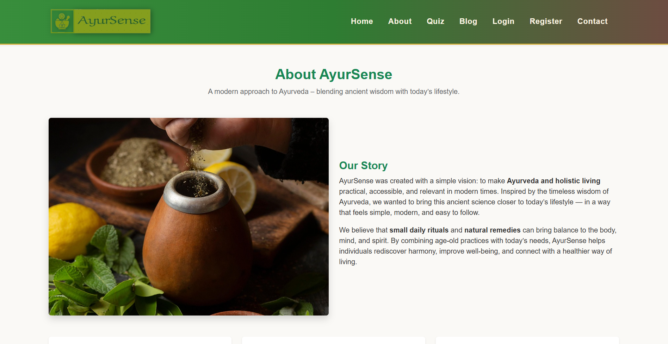

Slide 18
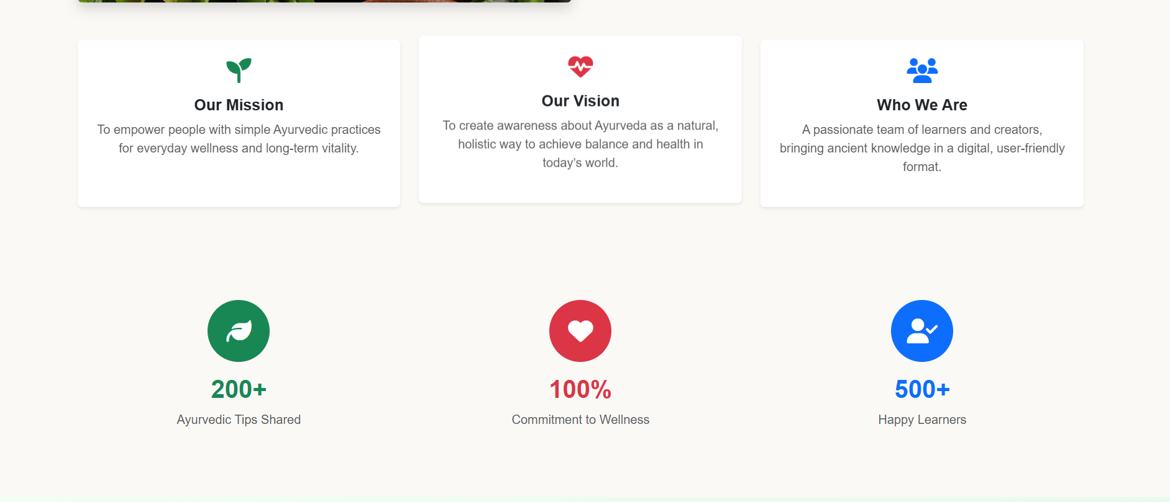

Slide 19
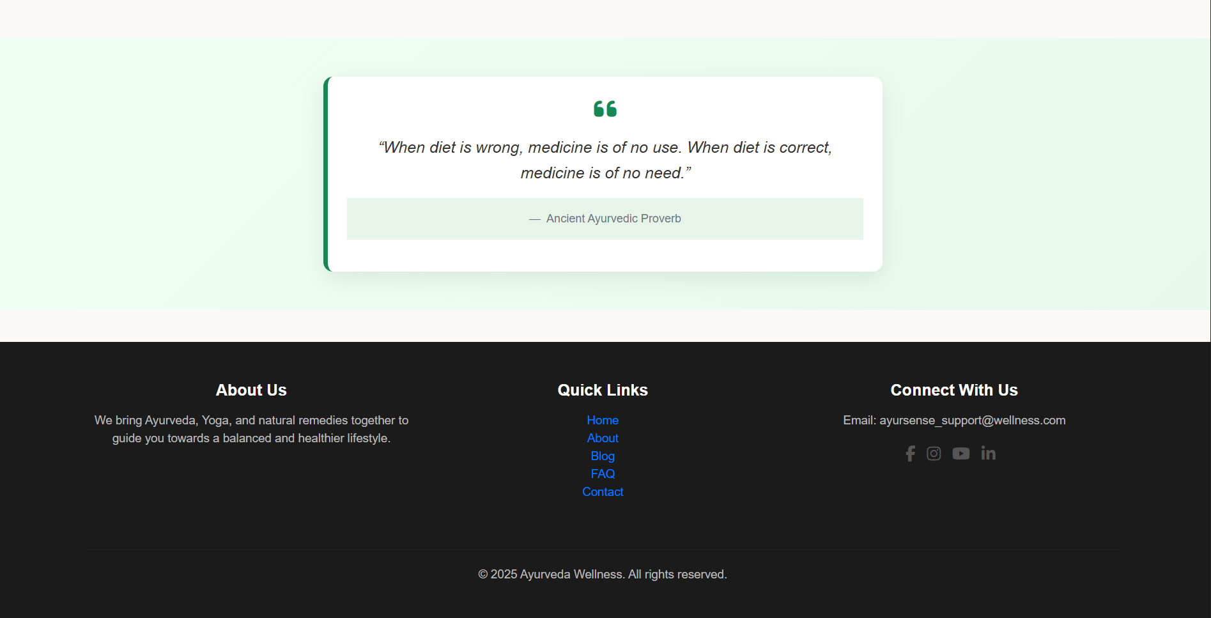

Slide 20
Target Journals/Conferences
Planning to submit in reputed conferences/journals on healthcare, AI, and Ayurveda..
Collaboration & Guidance Working under guidance of faculty mentors for refinement. Exploring collaboration with Ayurveda practitioners for validation.
Future Scope for Publication Potential for case studies based on real user feedback. Expansion into international digital health research platform.
Research Paper Drafting
Preparing manuscript highlighting AyurSense methodology, results, and impact.
Efforts Towards Publication

Slide 21

CONCLUSION
AyurSense provides a personalized Ayurvedic health guidance platform using AI.
It bridges the gap between traditional wisdom and modern digital solutions.
Helps users adopt natural, side-effect free remedies instead of over-dependence on medicines.
Ensures accessibility, awareness, and trust in Ayurveda through a simple web application.
Future enhancements can include mobile app integration, real-time chat with experts, and multilingual support.

Slide 22
REFERENCES
1. Lad, Vasant. The Complete Book of Ayurvedic Home Remedies. Harmony Books, 2002. 2. Frawley, David. Ayurveda and the Mind: The Healing of Consciousness. Lotus Press, 1997. 3. Sharma, P. V. Charaka Samhita – English Translation of Ayurveda Classic. Chaukhamba Orientalia, 2014. 4. World Health Organization (WHO). Global Report on Traditional and Complementary Medicine 2019. WHO Press, 2019. 5. Ministry of AYUSH, Government of India. Ayush Systems – An Overview. https://www.ayush.gov.in 6. Ministry of Health & Family Welfare, Government of India. National Health Profile 2022. https://www.cbhidghs.nic.in 7. Narayanasamy, A. (2015). "Ayurveda and Yoga: A Holistic Approach to Health." Journal of Traditional Medicine & Clinical Naturopathy, 4(2). 8. Joshi, R., & Dwivedi, R. (2018). "Integrating Ayurveda with Modern Digital Platforms for Lifestyle Disease Management." International Journal of Health Sciences and Research, 8(6), 221–227. 9. Google Scholar Database – Research on “AI in Ayurveda Recommendation Systems”. https://scholar.google.com 10. Indian Council of Medical Research (ICMR). Lifestyle Diseases Statistics Report 2021. https://www.icmr.gov.in 11. Ministry of Electronics & Information Technology (MeitY). Digital India Initiative. https://www.digitalindia.gov.in

Slide 23


Slide 29
User
Stores user details like name, email, gender, age.
1
Feedback
Captures ratings and comments from user
2

Slide 30




Wireframing
Wireframing is the basic layout design of BookMyExpert's interface, showing where elements like buttons, menus, and forms will appear—without any colors or final design.
Tools
Tools like Figma, Adobe XD, and Sketch are used to design wireframes and prototypes for BookMyExpert, ensuring clear design planning.
STEP 04
STEP 02
STEP 03
STEP 01
Prototyping
Prototyping creates a clickable, interactive model of BookMyExpert, helping visualize user flow and test how booking, login, and profile features will work.
Screens
Screens refer to the main pages of BookMyExpert—such as Login, Home, Expert Listing, Booking Page, and User Dashboard.

Slide 31




1
4
Used to create the basic structure and content of the website such as headings, forms, and buttons.
Used for building fast and responsive user interfaces like expert dashboards, search filters, and booking workflows.
Front-end Technology Used
2
Applied for styling the website—colors, fonts, layouts, and responsiveness to enhance visual appeal and user experience.
3
Adds interactivity to the site—like dynamic expert listings, form validations, and real-time feedback during booking.

Slide 32



Development Process
Involved planning, designing, coding, and testing. We used HTML, CSS, and JavaScript, ensured that all features like expert booking, user login, and scheduling worked smoothly.
Responsive Design
Responsive design ensures the website works well on all devices like mobiles, tablets, and desktops. We used flexible layouts and media queries so users can access "BookMyExpert" easily on any screen size.
Accessible Design
Accessible design makes the website usable for everyone, including people with disabilities. "BookMyExpert" includes proper labels, keyboard navigation, and readable fonts to ensure easy access for all users.

Slide 33



Data Integration
Data integration means combining data from different sources (like user profiles, expert schedules, and feedback) into one system so that "BookMyExpert" runs smoothly and gives a complete view to both users and admins.
Data
Data refers to raw facts collected from users and experts on the website, like names, email addresses, available time slots, and service categories.
Information
Information is processed data that provides meaning. For example, when data is organized to show which expert is available at what time, it becomes useful information for booking.

Slide 34



1
2
3
API
APIs (Application Programming Interfaces) help "BookMyExpert" connect with other services, like sending confirmation emails or integrating calendar bookings, making the website more functional and user-friendly.
Dataset Usage
The website uses datasets like user details, expert profiles, and booking history to manage services, show relevant experts, and improve user experience through smart suggestions.
Overview of Website
"BookMyExpert" is an online platform where users can easily find and book experts from different fields. It offers features like expert listings, user registration, schedule booking, and feedback submission.

Slide 35

03
Steps to build: Plan, Design, Develop, Test, Optimize, Maintain
02
Optimization: It improves speed, mobile compatibility, and SEO so the site loads faster and performs better.
01
Testing: It checks if the website works properly. We test forms, links, pages, and responsiveness to find and fix errors.

Slide 36
Deployment: Deployment means making your website live on the internet so users can access it through a web browser.
1-Prepare the Code:
Finalize your website files (HTML, CSS, JS).
Ensure everything is tested and working locally.
4-Go Live and Monitor:
After successful upload, your website becomes live.
Monitor performance, test again online, and fix any live issues.
2-Choose a Hosting Platform:
Select a platform like GitHub Pages, Netlify, Vercel, or Hostinger.
For dynamic features (like booking forms), you may need a backend server (e.g., Firebase or Node.js hosting).
3-Upload Website Files:
Connect your GitHub repository or manually upload files to the hosting provider.
Configure the domain (custom or provided).

Slide 37




A
B
C
D
"BookMyExpert" is an online platform designed to connect users with professionals and experts across various fields such as healthcare, education, legal advice, and more. The website allows users to browse expert profiles, check availability, and book appointments easily. The aim is to simplify the expert consultation process and save time through a user-friendly and accessible digital interface.
The website includes key features such as expert search, filter options by category or availability, user registration and login, appointment booking, and a feedback system. Experts can manage their slots and availability, while users receive confirmation and reminders. The responsive design ensures smooth performance on both desktop and mobile devices.
"BookMyExpert" is built using front-end technologies like HTML, CSS, and JavaScript for the user interface. Bootstrap is used for responsive design. Backend services can include Firebase or Node.js for authentication and data storage. APIs may be integrated for appointment scheduling and notifications.
The website is deployed using platforms like GitHub Pages or Netlify, ensuring it is accessible online. After deployment, regular testing, performance checks, and content updates are conducted to maintain quality. Feedback from users helps in continuous improvement, ensuring the platform remains effective and user-focused.

